Slide 1
Biology Laboratory Safety
Natural Sciences Department, LaGCC
When practiced safely, Biology laboratories
are exciting, rewarding and fun!

Slide 2
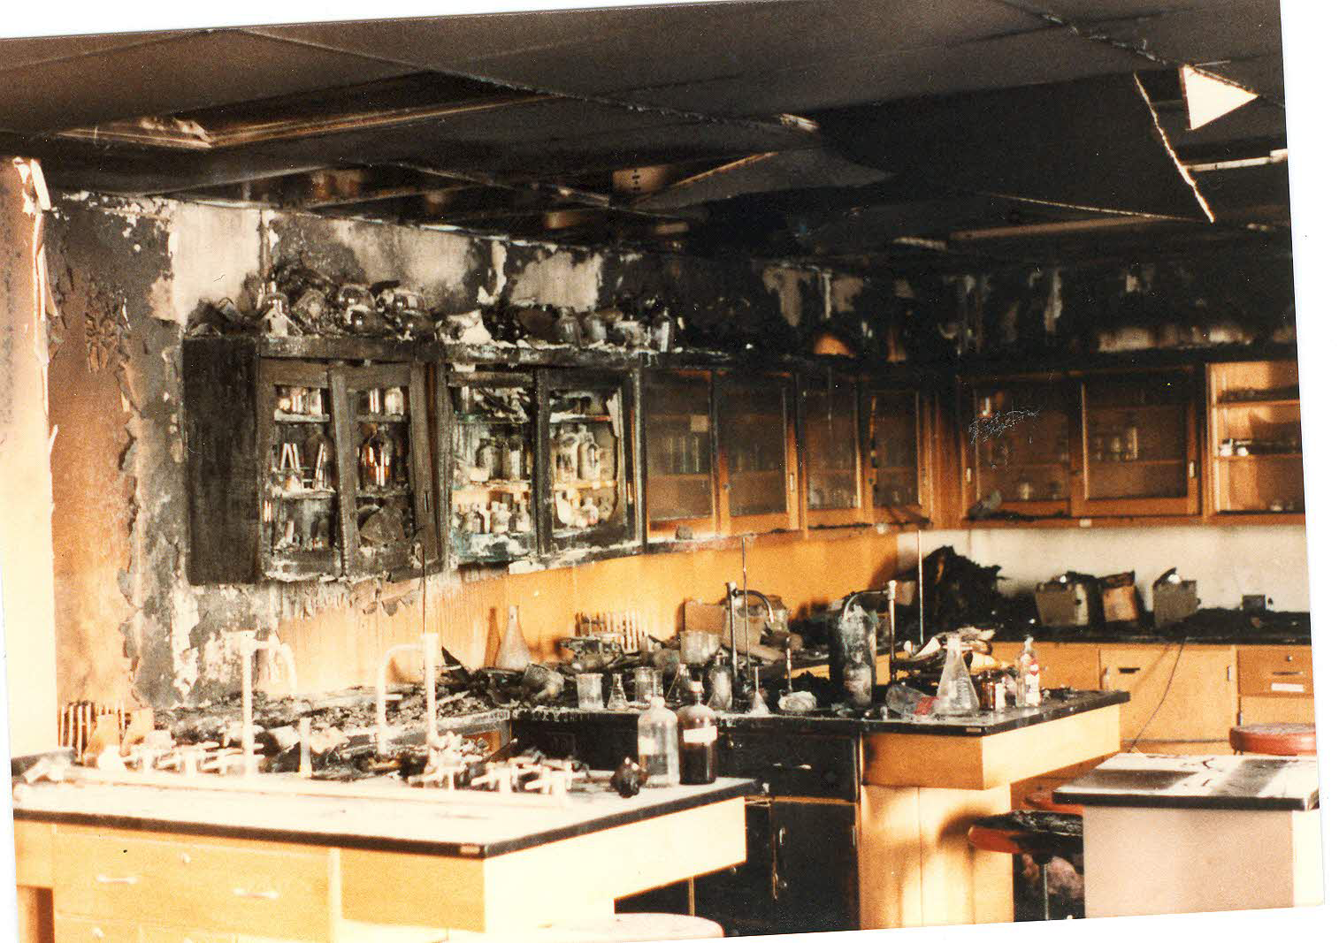
Accidents Happen but they are Preventable

Slide 3
General Laboratory Safety
Know the locations of laboratory safety features including:
Fire extinguishers
Fire blankets
Emergency exits
Safety showers
Eyewash stations
First aid kits
Fume hoods
Spill control kit
Notes:
Peter’s Comment: Add Spill containment Material

Slide 4
Food and drinks
NO eating (includes gum and candy) and/or drinking* in the laboratories.
All food and beverages must be out of sight at all times.
Do not dispose of food/beverages in the laboratory waste bin.
Including water bottles!

Slide 5
Proper attire
Non-compliant students will be asked to leave the laboratory
Limit skin exposure
Shorts
Sleeveless shirts * (tank tops, and crop tops, etc.)
Skirts or dresses shorter than calf length
*lab coats may be worn to cover upper body skin exposure only.

Slide 6
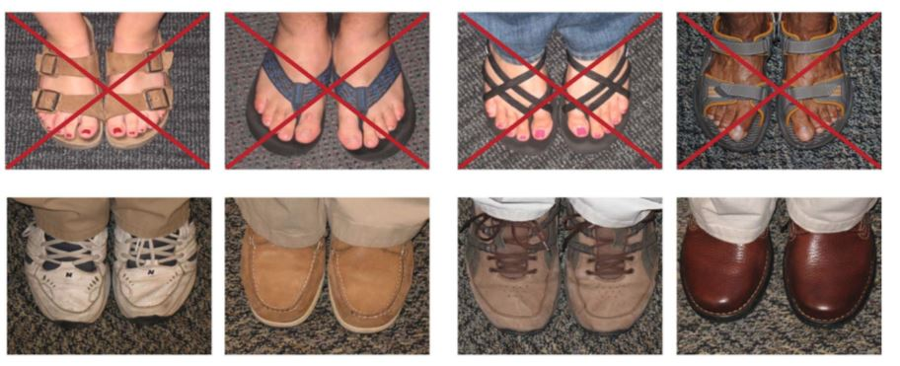
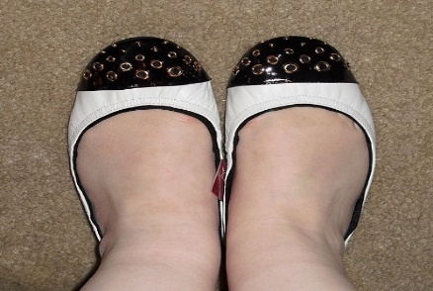
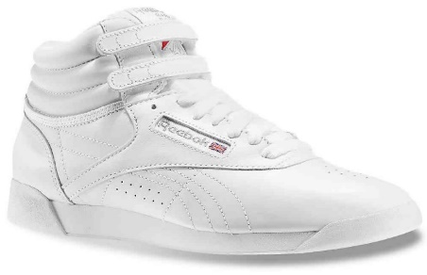
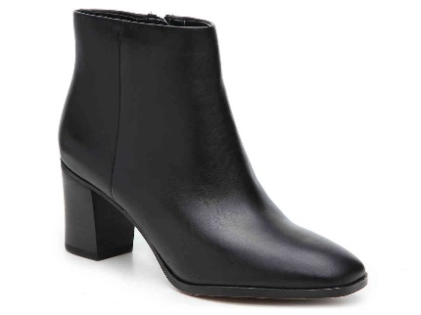
Proper attire
Shoes must enclose the entire foot (NO sandals, crocs, slippers, or flats).
✓
✓
✓
✓

Slide 7
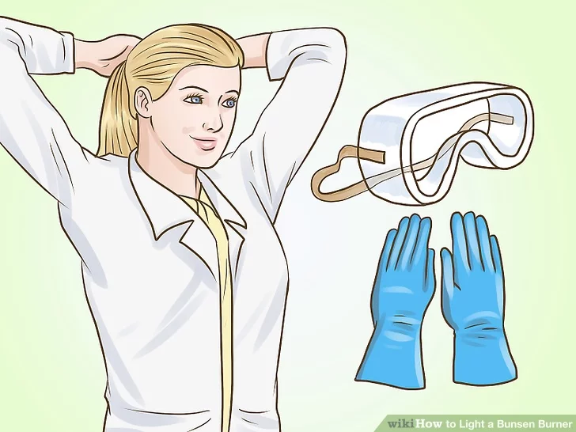
Proper attire
Always confine long hair, loose clothing/jewelry, accessories, corded headphones and earphones out of the way to avoid contact with flames or chemicals.
Do not apply make-up, hand lotions, lip moisturizers inside the laboratories.

Slide 8
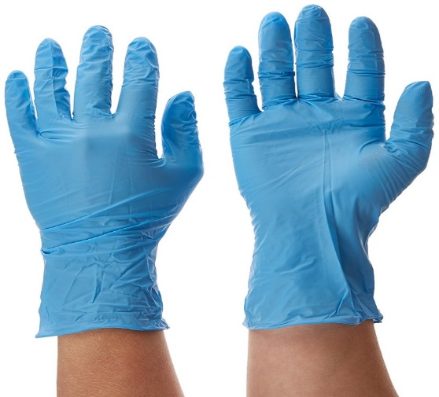
Personal protective equipment
Students must wear chemical resistant gloves (nitrile gloves recommended) while performing dissections/working with MICROORGANISMS, or waste.

Slide 9
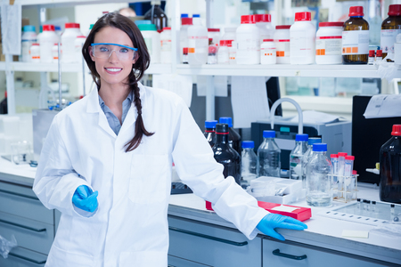
Personal protective equipment
Students must wear lab coats when working in microbiology labs.
It is recommended not to wear the lab coats outside the laboratories to avoid cross contamination.

Slide 10
Personal protective equipment
Students must wear safety goggles when working with chemicals at all times.

